Slide 1

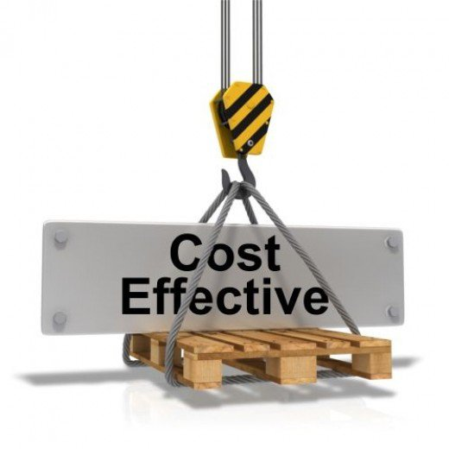

DEVOPS
Approach to Devops
Delivery By :
Ramkumar Balasubramanian
Presented By : BISP Solutions INC
www.bispsolutions.com
Notes:
Links:
2 TSG homepage

Slide 2
Approach to Devops
In this session of Devops, we will learn the following
Goals of Devops
Approach to Devops
Twelve Principles of Agile Methodology
Scrum techniques in Agile Methodology
Kanban Technique
UX development – Agile Methodology
www.bispsolutions.com

Slide 3
Goals of Devops
Devops aims at the following results
1
2
3
Improved deployment frequency
Faster time to market
Lower failure rate of new releases
4
5
Shortened lead time between fixes
Faster mean time to recovery
www.bispsolutions.com

Slide 4
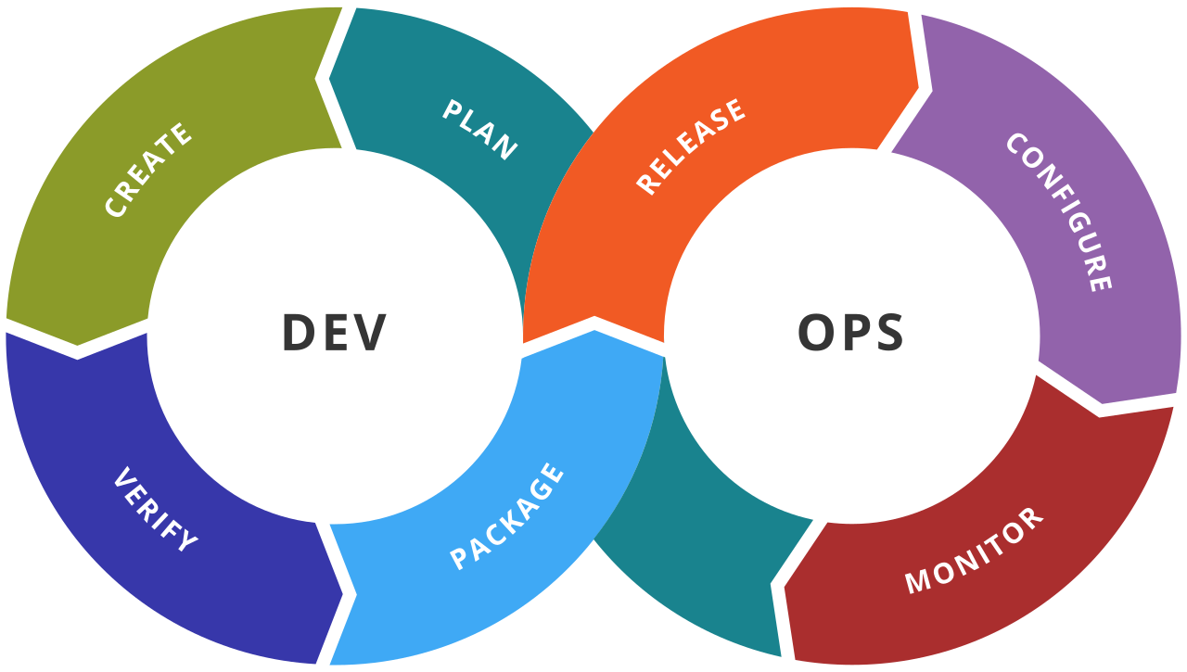

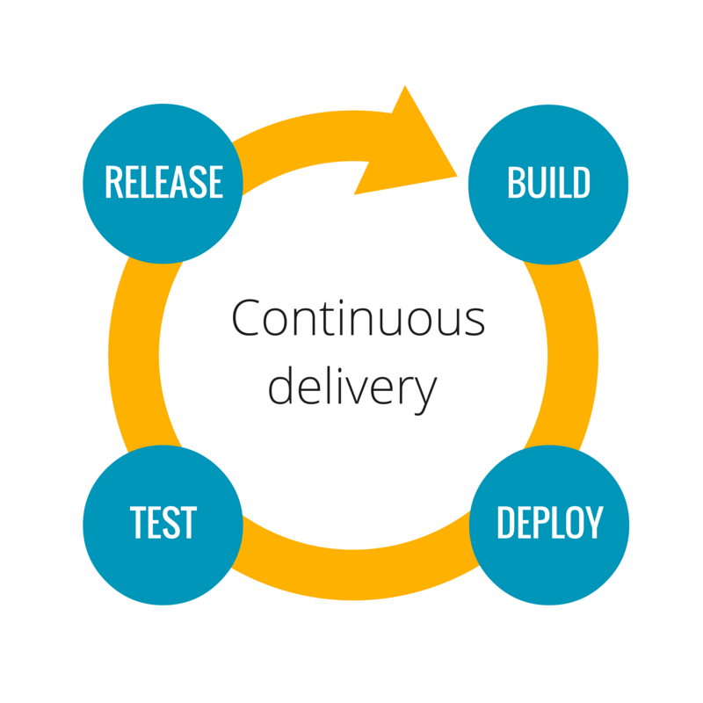
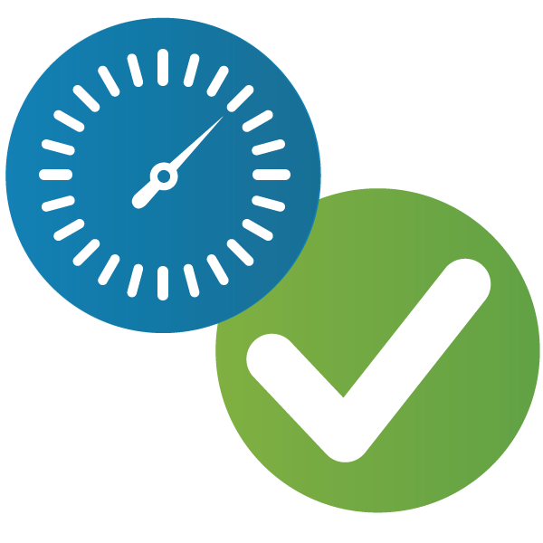
Approach to Devops
Devops consists of these approaches
DevOps
Agile Development
Continuous delivery
Site reliability engineering
www.bispsolutions.com

Slide 5
Devops with Agile Software Development
Devops arose from increasing success of Agile methodology
Organisations want to release software faster and more frequently
Strain on release management process led to application release automation
www.bispsolutions.com

Slide 6
Twelve principles of Agile Methodology
1
Customer satisfaction by early and continuous delivery of valuable software
2
Welcome changing requirements, even in late development
3
Working software is delivered frequently (weeks rather than months)
4
Close, daily cooperation between business people and developers
www.bispsolutions.com

Slide 7
Twelve principles of Agile Methodology
5
Projects are built around motivated individuals, who should be trusted
6
Face to face conversation is the best form of communication (co location)
7
Working software is the primary measure of progress
8
Sustainable development, able to maintain a constant pace
www.bispsolutions.com

Slide 8
Twelve principles of Agile Methodology
9
Continuous attention to technical excellence and good design
10
Simplicity - the art of maximizing the amount of work not done is essential
11
Best architectures, requirements, and designs emerge from self organizing teams
12
Regularly, the team reflects on how to become more effective, and adjusts accordingly
www.bispsolutions.com

Slide 9
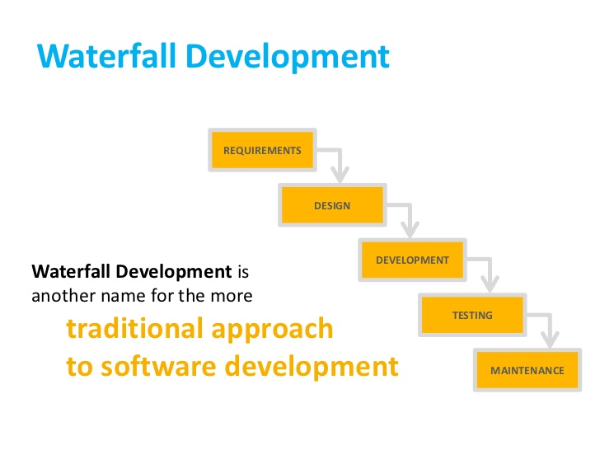
Agile Methodology – Software Development
www.bispsolutions.com

Slide 10
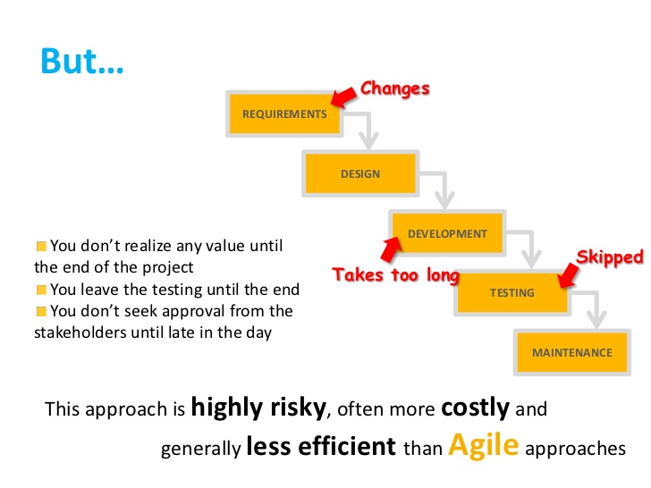
Agile Methodology – Software Development
Accelerated Time to Market
CD lets an organization deliver the business value inherent in new software releases to customers more quickly. This capability helps the company stay a step ahead of the competition.
Building e Right Product
Frequent releases let the application development teams obtain user feedback more quickly. This lets them work on only the useful features. If they find that a feature isn’t useful, they spend no further effort on it. This helps them build the right product.
www.bispsolutions.com

Slide 11
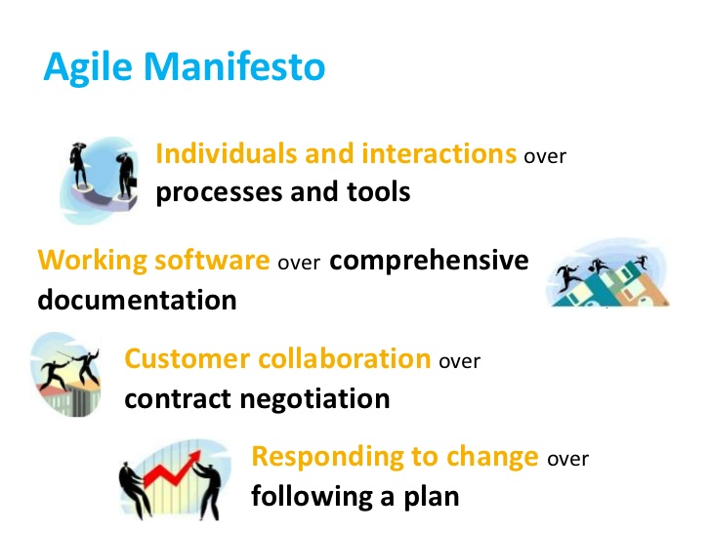
Agile Methodology – Software Development
Accelerated Time to Market
CD lets an organization deliver the business value inherent in new software releases to customers more quickly. This capability helps the company stay a step ahead of the competition.
Building e Right Product
Frequent releases let the application development teams obtain user feedback more quickly. This lets them work on only the useful features. If they find that a feature isn’t useful, they spend no further effort on it. This helps them build the right product.
www.bispsolutions.com

Slide 12
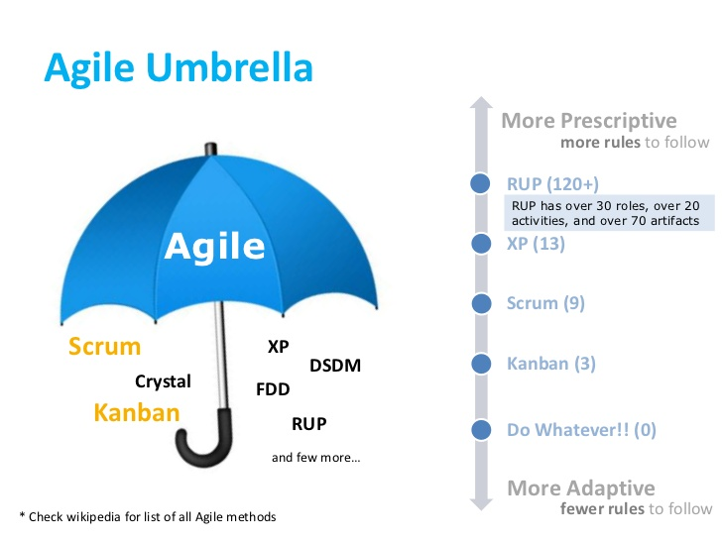
Agile Methodology – Software Development
Accelerated Time to Market
CD lets an organization deliver the business value inherent in new software releases to customers more quickly. This capability helps the company stay a step ahead of the competition.
Building e Right Product
Frequent releases let the application development teams obtain user feedback more quickly. This lets them work on only the useful features. If they find that a feature isn’t useful, they spend no further effort on it. This helps them build the right product.
www.bispsolutions.com

Slide 13
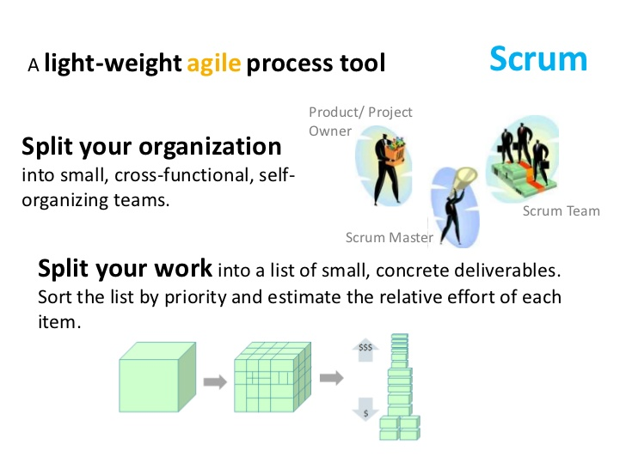
Agile Methodology – Scrum Technique
Accelerated Time to Market
CD lets an organization deliver the business value inherent in new software releases to customers more quickly. This capability helps the company stay a step ahead of the competition.
Building e Right Product
Frequent releases let the application development teams obtain user feedback more quickly. This lets them work on only the useful features. If they find that a feature isn’t useful, they spend no further effort on it. This helps them build the right product.
www.bispsolutions.com

Slide 14
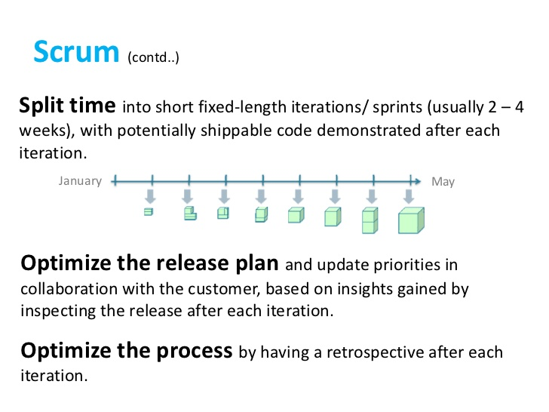
Agile Methodology – Scrum Technique
Accelerated Time to Market
CD lets an organization deliver the business value inherent in new software releases to customers more quickly. This capability helps the company stay a step ahead of the competition.
Building e Right Product
Frequent releases let the application development teams obtain user feedback more quickly. This lets them work on only the useful features. If they find that a feature isn’t useful, they spend no further effort on it. This helps them build the right product.
www.bispsolutions.com

Slide 15
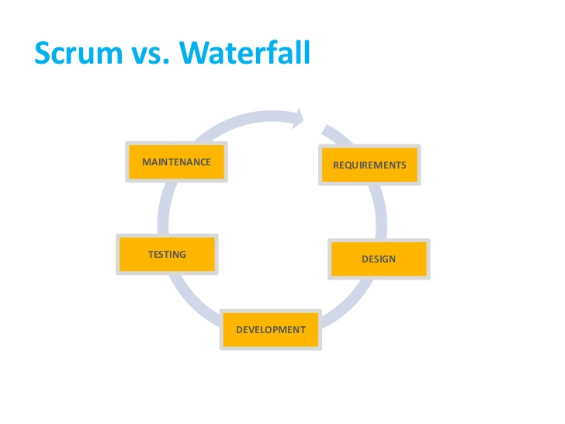
Agile Methodology – Scrum vs Waterfall
Accelerated Time to Market
CD lets an organization deliver the business value inherent in new software releases to customers more quickly. This capability helps the company stay a step ahead of the competition.
Building e Right Product
Frequent releases let the application development teams obtain user feedback more quickly. This lets them work on only the useful features. If they find that a feature isn’t useful, they spend no further effort on it. This helps them build the right product.
www.bispsolutions.com

Slide 16
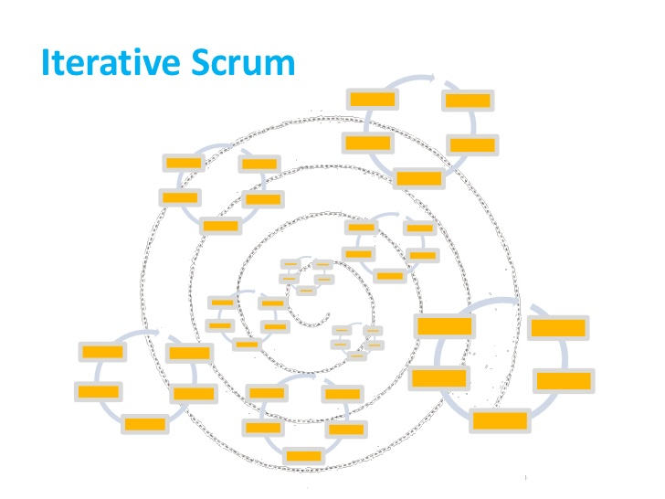
Agile Methodology – Iterative Scrum
Accelerated Time to Market
Building e Right Product
Frequent releases let the application development teams obtain user feedback more quickly. This lets them work on only the useful features. If they find that a feature isn’t useful, they spend no further effort on it. This helps them build the right product.
CD lets an organization deliver the business value inherent in new software releases to customers more quickly. This capability helps the company stay a step ahead of the competition.
www.bispsolutions.com

Slide 17
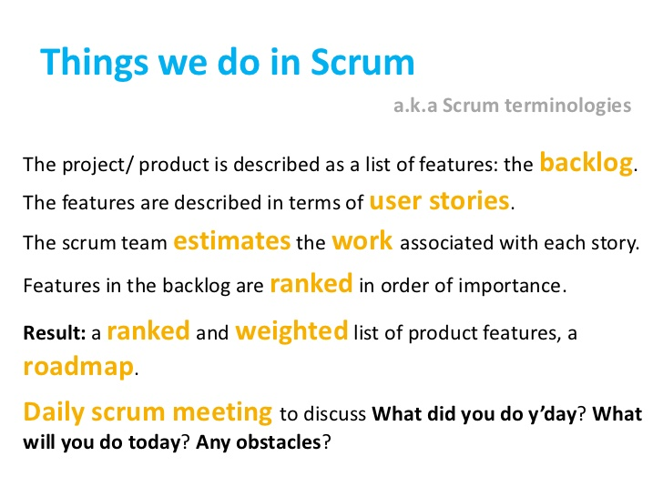
Agile Methodology – Things we do in Scrum
Accelerated Time to Market
Building e Right Product
Frequent releases let the application development teams obtain user feedback more quickly. This lets them work on only the useful features. If they find that a feature isn’t useful, they spend no further effort on it. This helps them build the right product.
CD lets an organization deliver the business value inherent in new software releases to customers more quickly. This capability helps the company stay a step ahead of the competition.
www.bispsolutions.com

Slide 18
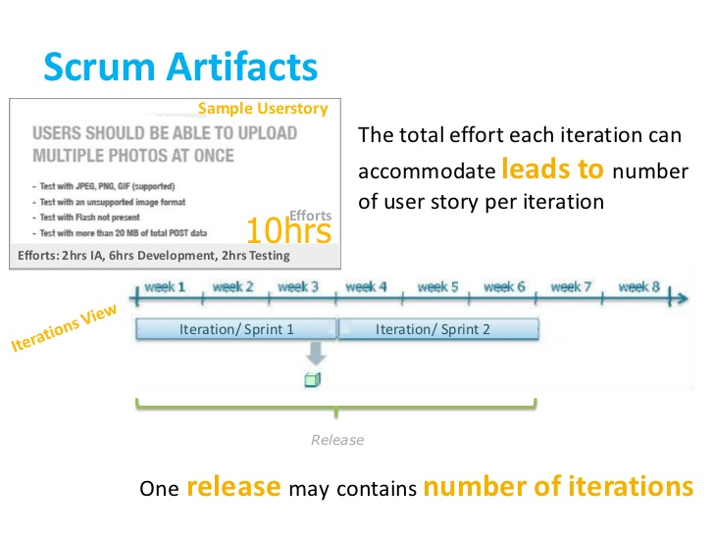
Agile Methodology – Scrum Artifacts
Accelerated Time to Market
Building e Right Product
Frequent releases let the application development teams obtain user feedback more quickly. This lets them work on only the useful features. If they find that a feature isn’t useful, they spend no further effort on it. This helps them build the right product.
CD lets an organization deliver the business value inherent in new software releases to customers more quickly. This capability helps the company stay a step ahead of the competition.
www.bispsolutions.com

Slide 19
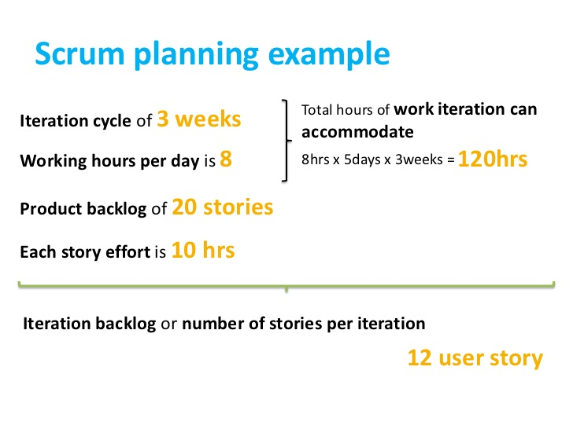
Agile Methodology – Planning Example
Accelerated Time to Market
Building e Right Product
Frequent releases let the application development teams obtain user feedback more quickly. This lets them work on only the useful features. If they find that a feature isn’t useful, they spend no further effort on it. This helps them build the right product.
CD lets an organization deliver the business value inherent in new software releases to customers more quickly. This capability helps the company stay a step ahead of the competition.
www.bispsolutions.com

Slide 20
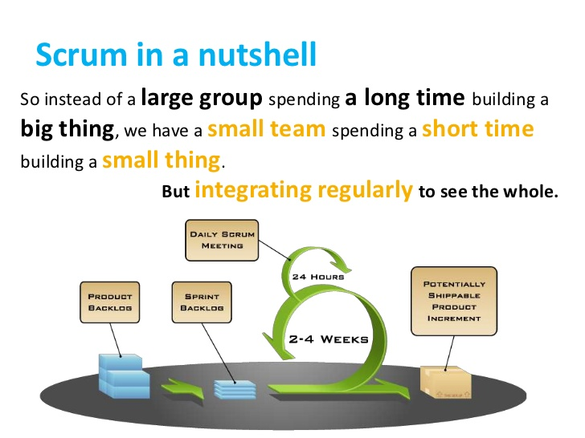
Agile Methodology – Scrum in a Nutshell
Accelerated Time to Market
Building e Right Product
Frequent releases let the application development teams obtain user feedback more quickly. This lets them work on only the useful features. If they find that a feature isn’t useful, they spend no further effort on it. This helps them build the right product.
CD lets an organization deliver the business value inherent in new software releases to customers more quickly. This capability helps the company stay a step ahead of the competition.
www.bispsolutions.com

Slide 21
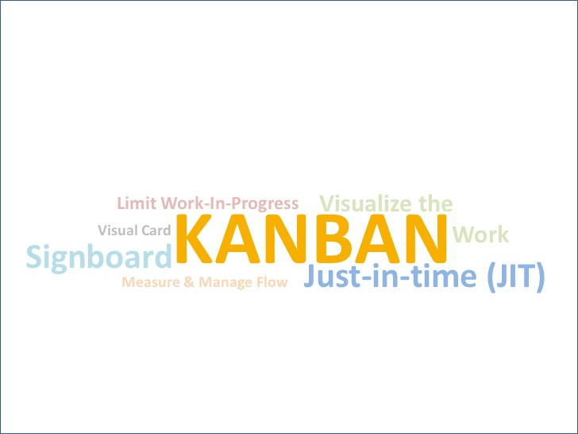
Agile Methodology – Kanban
Accelerated Time to Market
Building e Right Product
Frequent releases let the application development teams obtain user feedback more quickly. This lets them work on only the useful features. If they find that a feature isn’t useful, they spend no further effort on it. This helps them build the right product.
CD lets an organization deliver the business value inherent in new software releases to customers more quickly. This capability helps the company stay a step ahead of the competition.
www.bispsolutions.com

Slide 22
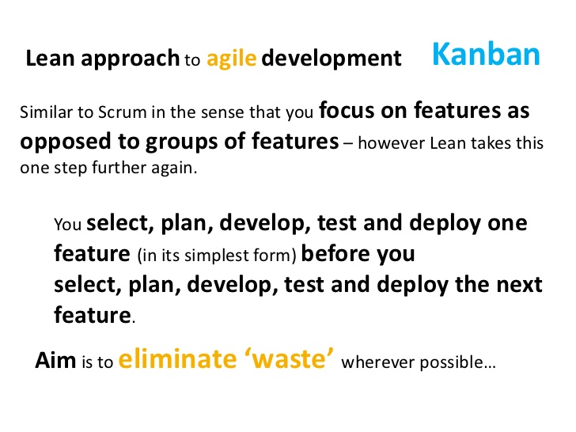
Agile Methodology – Kanban
Accelerated Time to Market
Building e Right Product
Frequent releases let the application development teams obtain user feedback more quickly. This lets them work on only the useful features. If they find that a feature isn’t useful, they spend no further effort on it. This helps them build the right product.
CD lets an organization deliver the business value inherent in new software releases to customers more quickly. This capability helps the company stay a step ahead of the competition.
www.bispsolutions.com

Slide 23
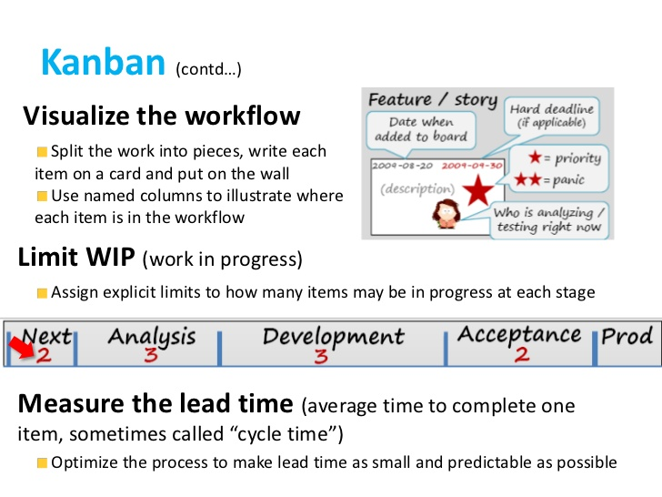
Agile Methodology – Kanban
Accelerated Time to Market
Building e Right Product
Frequent releases let the application development teams obtain user feedback more quickly. This lets them work on only the useful features. If they find that a feature isn’t useful, they spend no further effort on it. This helps them build the right product.
CD lets an organization deliver the business value inherent in new software releases to customers more quickly. This capability helps the company stay a step ahead of the competition.
www.bispsolutions.com

Slide 24
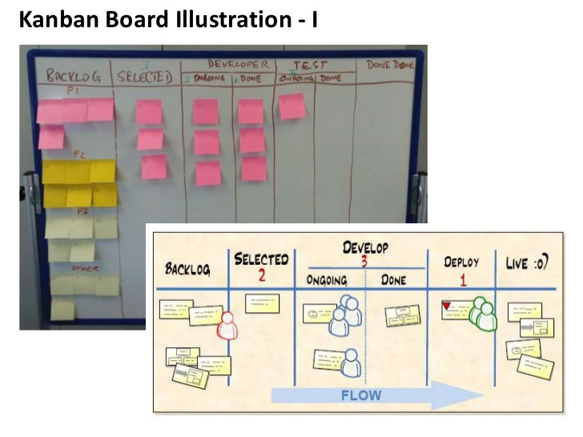
Agile Methodology – Kanban
Accelerated Time to Market
Building e Right Product
Frequent releases let the application development teams obtain user feedback more quickly. This lets them work on only the useful features. If they find that a feature isn’t useful, they spend no further effort on it. This helps them build the right product.
CD lets an organization deliver the business value inherent in new software releases to customers more quickly. This capability helps the company stay a step ahead of the competition.
www.bispsolutions.com

Slide 25
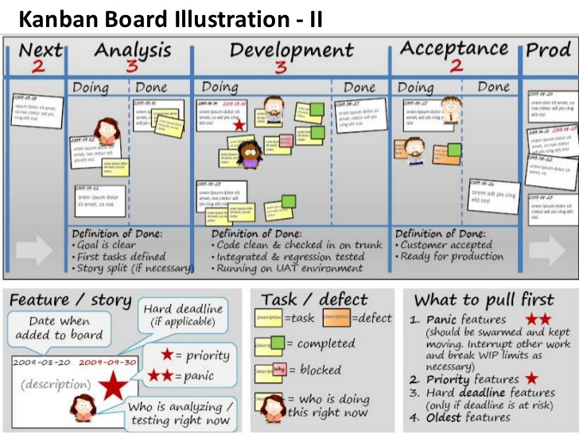
Agile Methodology – Kanban
Building e Right Product
Frequent releases let the application development teams obtain user feedback more quickly. This lets them work on only the useful features. If they find that a feature isn’t useful, they spend no further effort on it. This helps them build the right product.
Accelerated Time to Market
CD lets an organization deliver the business value inherent in new software releases to customers more quickly. This capability helps the company stay a step ahead of the competition.
www.bispsolutions.com

Slide 26

Agile Methodology – UX Development
Building e Right Product
Frequent releases let the application development teams obtain user feedback more quickly. This lets them work on only the useful features. If they find that a feature isn’t useful, they spend no further effort on it. This helps them build the right product.
Accelerated Time to Market
CD lets an organization deliver the business value inherent in new software releases to customers more quickly. This capability helps the company stay a step ahead of the competition.
www.bispsolutions.com

Slide 27
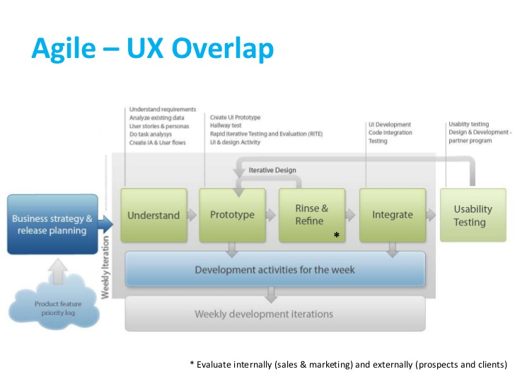
Agile Methodology – UX Development
Building e Right Product
Frequent releases let the application development teams obtain user feedback more quickly. This lets them work on only the useful features. If they find that a feature isn’t useful, they spend no further effort on it. This helps them build the right product.
Accelerated Time to Market
CD lets an organization deliver the business value inherent in new software releases to customers more quickly. This capability helps the company stay a step ahead of the competition.
www.bispsolutions.com

Slide 28
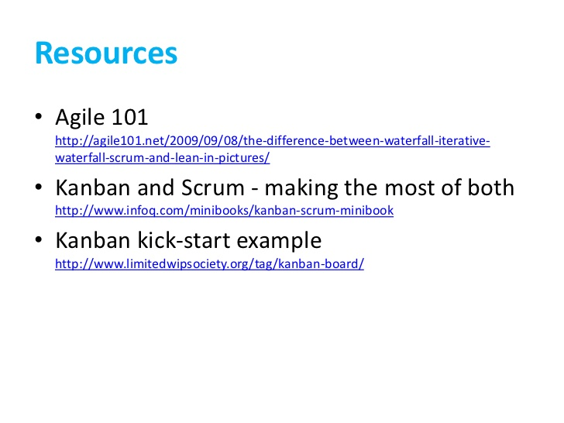
Agile Methodology – UX Development
Building e Right Product
Frequent releases let the application development teams obtain user feedback more quickly. This lets them work on only the useful features. If they find that a feature isn’t useful, they spend no further effort on it. This helps them build the right product.
Accelerated Time to Market
CD lets an organization deliver the business value inherent in new software releases to customers more quickly. This capability helps the company stay a step ahead of the competition.
www.bispsolutions.com

